Slide 1
Team Glorious Coders
Background
We are strategic career counselling firm and we create assessment that undergoes extensive reliability testing by renowned psychometricians and is created for today's millennials to help them find their perfect fit careers
Vision/Mission
We aim to guide the people of our country to an employed future in the field in which they excel.

Slide 2
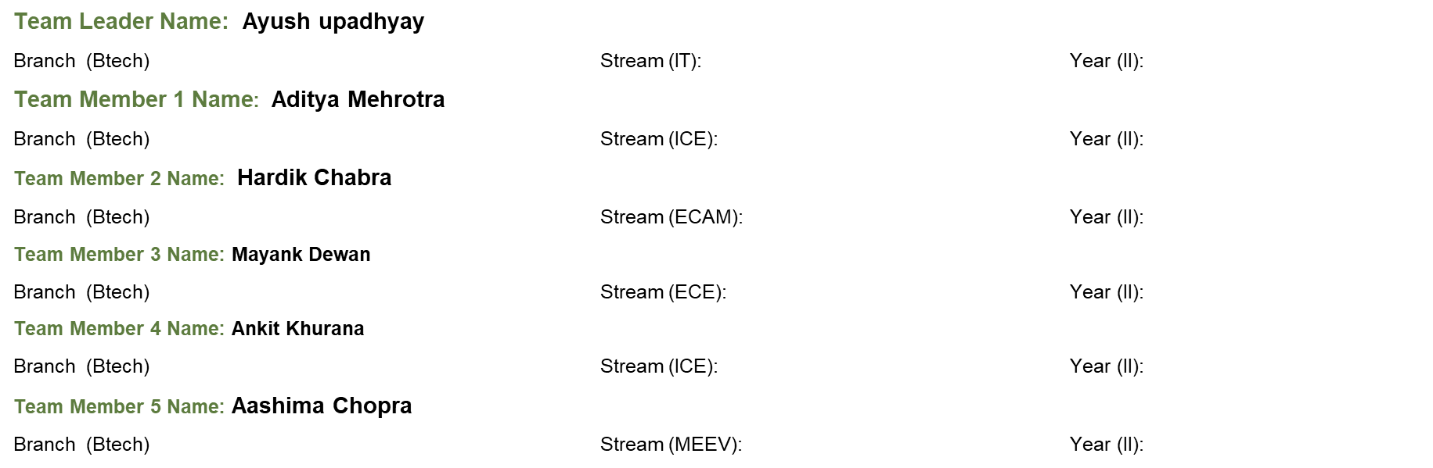
Career guidance System
Team Info

Slide 3
Problem
Lack of awareness about importance of career counselling in Education System
Imbalance in Demand/Supply of Career Guidance Experts across nation.
Limited reach due to unavailability of platform.

Slide 4
Solution
An AI-Based Website which recommends an individual the career path to choose based upon the factors like their strengths, weakness, age, interest and similar important factors.
(value to user)The website would help the user to find a career path he is really interested in and has the knowledge to do so.
The site would provide a platform for experts to comment and reply to the problems and question a student or user is having .
The site will use AI for generating a career path suitable for user on the based on the question answer by the user.

Slide 5
Market Size
Career counseling in India is a huge addressable market as currently India needs a minimum of 1.4 million career counselors to maintain a globally acceptable student to school counselor ratio.
While a few national boards have mandated schools to have counsellors, over 93% schools in India don’t have a professional counsellor on board.
Career Counselling is only now beginning to gain the recognition it deserves and is witnessing exponential growth as a profession. While the developed nations have recognised the criticality of career counselling
The market size for career assessment and guidance is currently estimated at over Rs 5,000 crore in India and continuously growing.

Slide 6
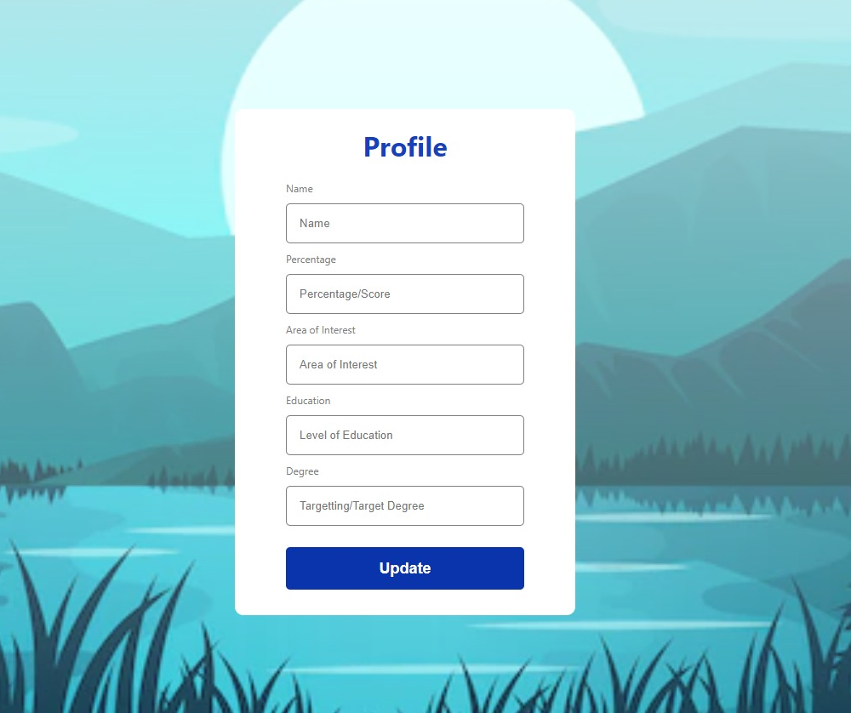
Product
Architecture
This is prototype of
ouridea.

Slide 7
Ecosystem
We are trying to build an ecosystem that helps not only the students but also the counsellors to be clear about their vision through their training programme.
Overall It provides a platform for self-growth and development as an individual.
Adjacent markets
Education Sector
Edtech Companies

Slide 8
Scalability
Current demographics of India:
As per a report, about 67% of India’s population is in the working-age of 15-64. Additionally, a majority of this is in the 15-30 years age bracket. This implies that more and more people need help to choose the right careers.
Broad career opportunities:
Career counselling is one of the rare few professions which allow you to work with school students, parents of these students, graduates, young professionals, and even mid-career professionals looking for a switch.
Technological advancement:
With the global availability of our web portal it will be very easy for people to connect with well-trained career counsellors across the nation.
Low investment need:
With the right certification and an industry-leading career counselling platform, one can operate as a career counsellor from almost any part of the country.

Slide 9
Market Validation
Development time
It will take approximately 3 days for us to Build the complete web application.
Notes:
Goto market- Timeline

Slide 10
Business Model
Opportunities- As a service,Product etc.
Sources of revenue
Intended customer base

Slide 11
Competition
Defensibility
Niche

Slide 12
Competitive advantages
Partnerships
We could partner up with school and help students explore various fields that exist
Strengths of technology/Team (USPs)
Everything happens online these days and making a web application to help people choose a career path has been due for a long period of time therefore our team is bringing forward this project.
Since this is a web application it is easily accessible to a everyone around the world

Slide 13
Financial model and projections
Investment to develop- Material and manpower
Hosting a server
Assumptions
We will be needing capital for marking and making this project more scalable
Return on Investment
We are developing a system in which experts or user will have to make on time payment to unlock premium account which will let them make comments on other peoples questions
This will encourage user to upgrade to a premium

Slide 14
Assumptions and risks
SWOT
Strength: Efficient and effective way to get career guidance.
Weakness: Platform does not provide and kind of physical mentorship (in person).
Opportunities: It can become a way to tie up with other companies who are seeking skilled professionals.
Threats: A similar model can be implemented by other companies thus forming a competition
CONCERNS and RESPONSES
With new jobs emerging and many jobs getting undervalued one of the major concern is that the website needs to be updated regularly so as to predict a stable career path at that point of time.
Risks and precautions:
One of the major concerns with this project is making sure forum is not being used for illegal activities and relevant content is being uploaded.
Moderators are needed to monitor the content which is passing through the website in case the AI fails to moderate the content completely.

Slide 15
Summary
Our website is a one stop solution for all the career related problems. This is a place where people can ask their career related questions and seek help from the people who are in a vast range of industries.
Forums on our site enable the users to post their queries and get advice from other people who have dealt with similar problems. Users can also give suggestions to other people seeking help.
FAQs section contains answers to some of the most commonly asked questions regarding choosing a career path and following one’s ambitions.
Our AI is also a great resource to exploit which tells you what career path is best for you depending on your skill set.

